Slide 1
6 - Transport Layer II
TCP Congestion Control
Sangmyung Univ., Dept of HC-AI

Slide 2
Review: TCP Window Control
Flow control
  Avoid overloading receiver
  Set by receiver
  rwnd: receive (advertised) window
  Receiver advertises rwnd with each ACK
Congestion control
  Avoid overloading network
  Set by sender
  Infer available network capacity
  cwnd: congestion window
Set W = min (cwnd, rwnd)

Slide 3
TCP Congestion control
Source calculates cwnd from indication of network congestion
Congestion indications in general
  Packet Loss (used in TCP)
  Delay
  Explicit Marks
Algorithms to calculate cwnd in TCP
  Various mechanisms: Tahoe, Reno, Vegas, RED, REM …

Slide 4
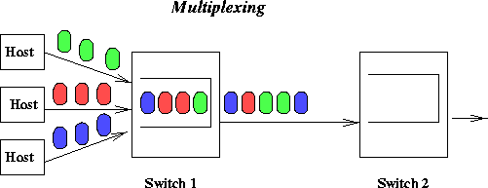
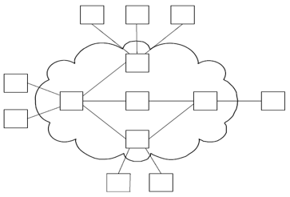
Packet Switching & Statistical Multiplexing
Packet Switching, used in computer/data networks, relies on statistical multiplexing for cost-effective resource sharing
Statistical multiplexing
  per-packet basis
  On demand link allocation:
    This is called “scheduling”. E.g. First In First Out (FIFO)
Buffer packets that are waiting for the link
Buffer buildup is called congestion

Slide 5
Principles of congestion control
congestion:
informally: “too many sources sending too much data too fast for network to handle”
  Short-term congestion: Can be solved with sufficient buffer space
  Long-term congestion: Can be solved by sending rate reduction
symptoms:
  lost packets
    buffer overflow at routers
  long delays
    queueing in router buffers

Slide 6
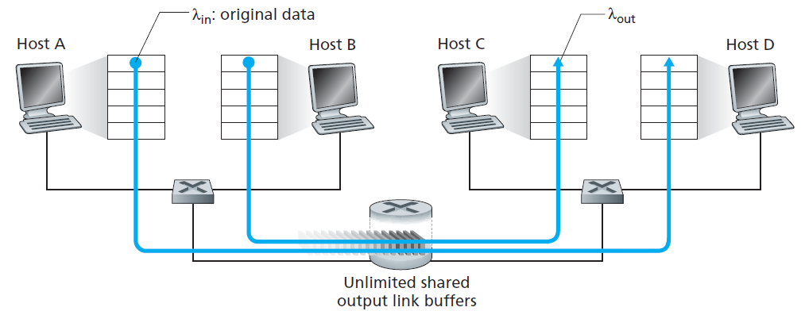
Causes/costs of congestion: scenario 1
two senders, two receivers
one router, infinite buffers
output link capacity: R
no retransmission
R/2
λ_{out}
delay
λ_{in}
R/2
λ_{in}
R/2
maximum per-connection
throughput: R/2
large delays as arrival rate, λ_{in},
approaches capacity

Slide 7
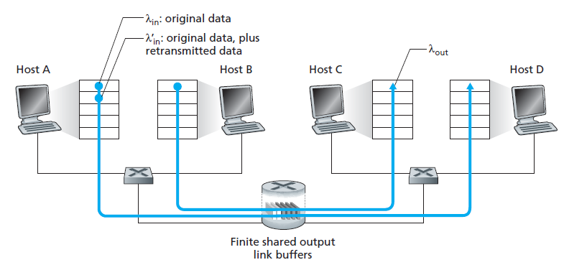
Causes/costs of congestion: scenario 2
one router, finite buffers
sender retransmits the timed-out packets
  application-layer input = application-layer output: λ_{in} = λ_{out}
  transport-layer input includes retransmissions : λ_{in}’ > λ_{in}
  retransmission of delayed (not lost) packet makes larger
λ_{in}’

Slide 8
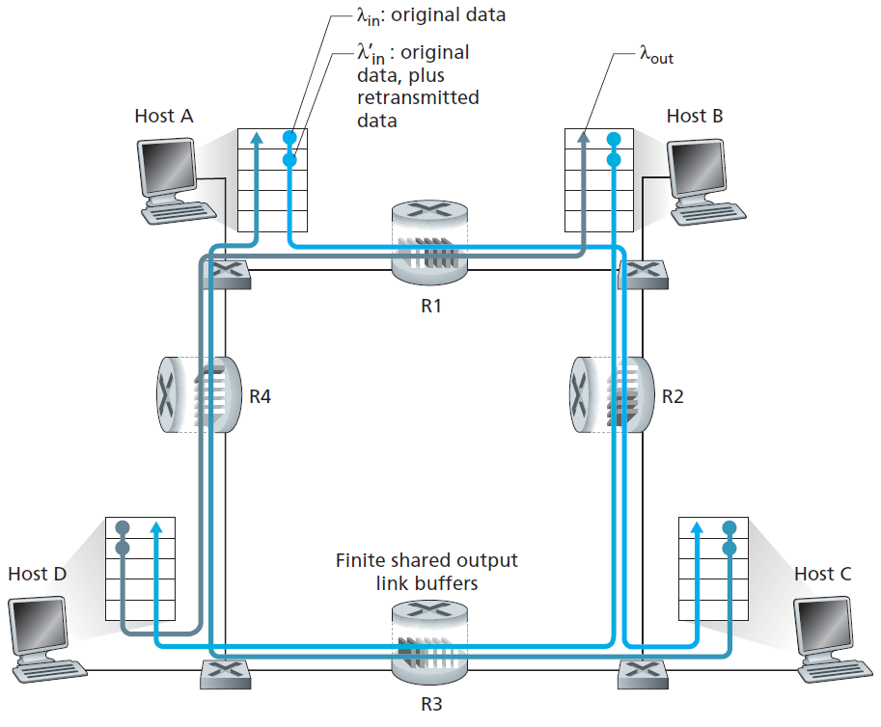
Causes/costs of congestion: scenario 3
four senders
multihop paths
timeout/retransmit
Q: what happens as λ_{in} and λ_{in}’ increase ?
A: as λ_{in}’ increases, all arriving original packets at upper queue are dropped, throughput → 0

Slide 9
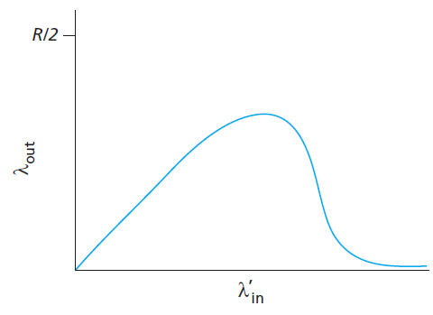
Causes/costs of congestion: scenario 3
As λ_{in}’ increases, all arriving original packets at upper queue are dropped, throughput → 0
another “cost” of congestion:
when packet dropped, any “upstream transmission capacity” used for that packet was wasted

Slide 10
Approaches towards congestion control
two broad approaches towards congestion control:
1. end-end congestion control:
no explicit feedback from network
congestion inferred from end-system observed loss, delay
Example: TCP
2. network-assisted congestion control:
routers provide feedback to end systems
  Feedback may include: single bit indicating congestion
  Or feedback specifies explicit rate for sender to send at
Example: ATM ABR

Slide 11
TCP congestion control: Original concept additive increase & multiplicative decrease
approach: sender increases transmission rate (window size), probing for usable bandwidth, until loss occurs
  additive increase: increase cwnd by 1 MSS every RTT until loss detected
  multiplicative decrease: cut cwnd in half after loss
Key assumption: a dropped packet and resultant timeout are due to congestion at a router.
additively increase window size …
…. until loss occurs (then cut window in half)
AIMD saw tooth behavior:
Probing for bandwidth
cwnd: TCP sender
congestion window size
time

Slide 12
Additive increase
Add one packet each RTT
Source
Destination

Slide 13
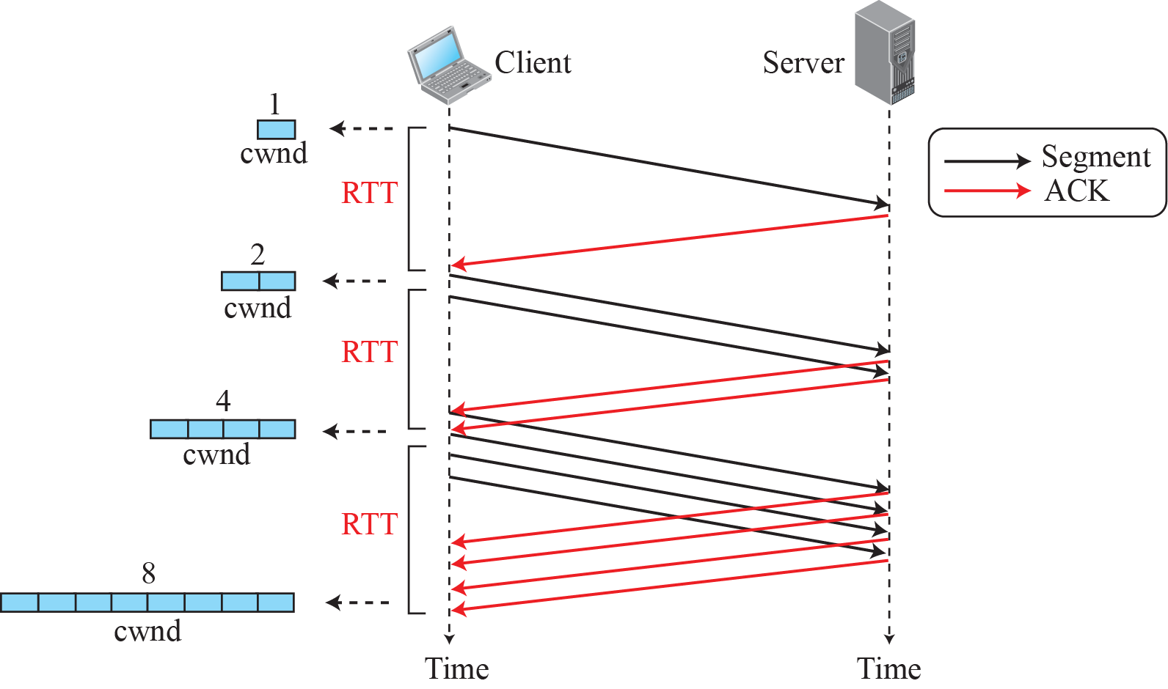
TCP “Slow Start” (exponential growth)
Linear additive increase takes too long to ramp up a new TCP connection from start.
Beginning with TCP Tahoe (2nd TCP), the slow start mechanism was added
Slow Start:
Add one packet
per ACK

Slide 14
TCP Tahoe (2nd version) congestion control
If loss is indicated,
  set threshold ← ½ of the current cwnd
  sets cwnd to 1 MSS;
  cwnd then grows exponentially (as in slow start) to threshold, then grows linearly

Slide 15
TCP Reno (3rd version) congestion control
If loss is indicated,
  set threshold ← ½ of the current cwnd
  if loss indicated by timeout:
    sets cwnd to 1 MSS;
    cwnd then grows exponentially (as in slow start) to threshold, then grows linearly
  if loss indicated by 3 duplicate ACKs:
    dup ACKs indicate network capable of delivering some segments
    cwnd is cut into half, then grows linearly

Slide 16
Variations on TCP
TCP Tahoe (1988):
  “slow start” introduced
  Fast retransmit (retransmit with 3 duplicate ACKs) was added.
  sets cwnd to 1 on every packet loss
TCP Reno (1990):
  cwnd is cut in half window on duplicate ACKs, then grows linearly (called Fast recovery)
TCP Vegas (1994):
  Measure RTT and guess congestion level
  Linearly increases/decreases based on current RTT

Slide 17
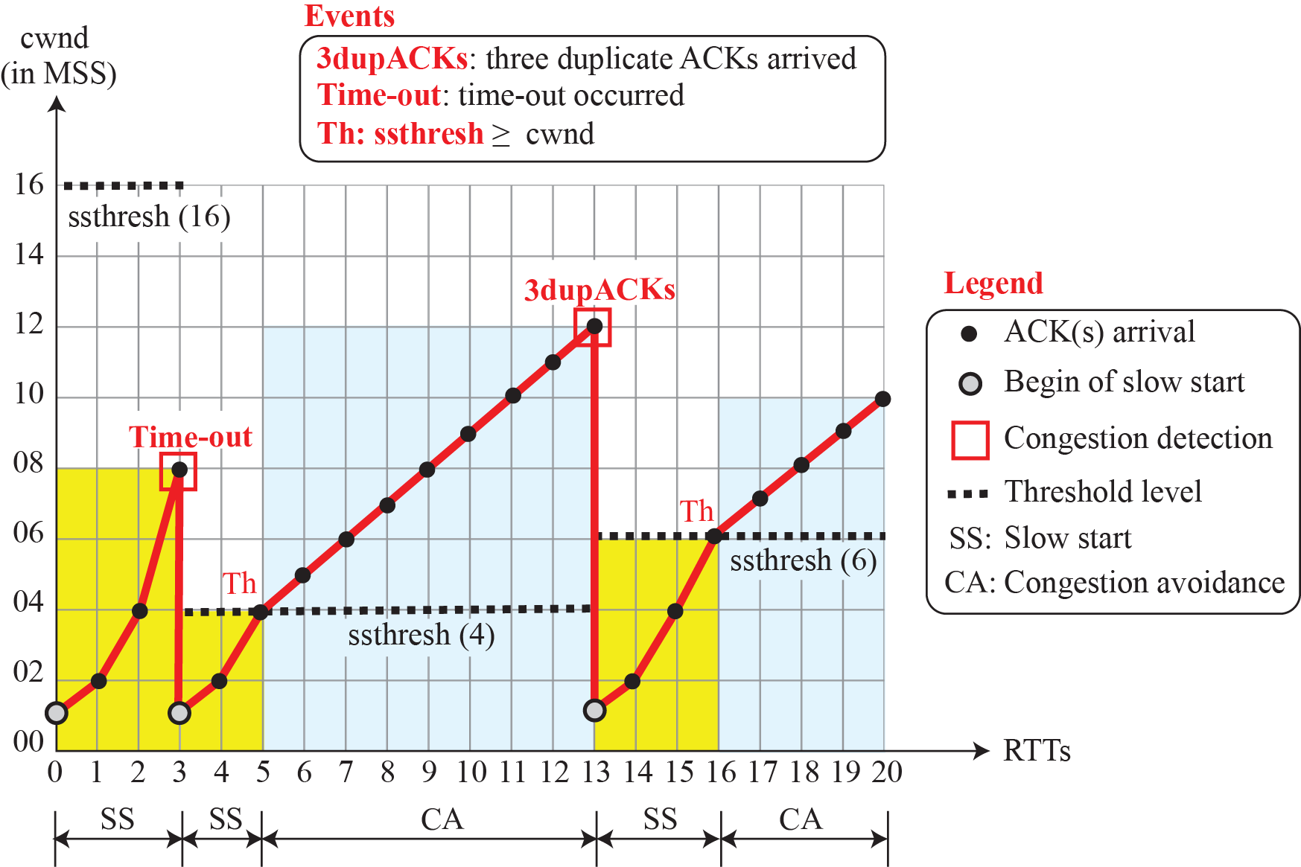
TCP Tahoe example

Slide 18
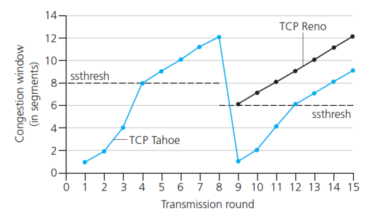
TCP: switching from slow start to CA
Q: when should the exponential increase switch to linear?
A: when cwnd gets to 1/2 of its value before timeout.
duplicate ACKs
Implementation:
variable ssthresh
on loss event, ssthresh is set to 1/2 of cwnd just before loss event

Slide 19
Lab 05 TCP

Slide 20
Instructions
Start up your web browser. Go the http://gaia.cs.umass.edu/wiresharklabs/alice.txt and retrieve an ASCII copy of Alice in Wonderland. Store this file somewhere on your computer.
Next go to http://gaia.cs.umass.edu/wireshark-labs/TCP-wireshark-file1.html.
Use the ‘Browse’ button to enter the name of the file (full path name) on your computer containing Alice in Wonderland (or do so manually). Don’t yet press the “Upload alice.txt file” button.
Now start up Wireshark and begin packet capture (Capture->Start) and then press OK on the Wireshark Packet Capture Options screen (we’ll not need to select any options here).
Returning to your browser, press the “Upload alice.txt file” button to upload the file to the gaia.cs.umass.edu server. Once the file has been uploaded, a short congratulations message will be displayed in your browser window.
Stop Wireshark packet capture.
Filter the packets displayed in the Wireshark window by entering “tcp” (lowercase)

Slide 21
Questions (Part 1/5)
What is the IP address and TCP port number used by the client computer (source) that is transferring the file to gaia.cs.umass.edu?
What is the IP address of gaia.cs.umass.edu? On what port number is it sending and receiving TCP segments for this connection?

Slide 22

Questions (Part 2/5)
What is the sequence number of the TCP SYN segment that is used to initiate the TCP connection between the client computer and gaia.cs.umass.edu? What is it in the segment that identifies the segment as a SYN segment?
What is the sequence number of the SYNACK segment sent by gaia.cs.umass.edu to the client computer in reply to the SYN? What is the value of the Acknowledgement field in the SYNACK segment? How did gaia.cs.umass.edu determine that value? What is it in the segment that identifies the segment as a SYNACK segment?
What is the sequence number of the TCP segment containing the HTTP POST command? Note that in order to find the POST command, you’ll need to dig into the packet content field at the bottom of the Wireshark window, looking for a segment with a “POST” within its DATA field.

Slide 23
Questions (Part 3/5)
Consider the TCP segment containing the HTTP POST as the first segment in the TCP connection.
  What are the sequence numbers of the first six segments in the TCP connection (including the segment containing the HTTP POST)?
  At what time was each segment sent? When was the ACK for each segment received?
  Given the difference between when each TCP segment was sent, and when its acknowledgement was received, what is the RTT value for each of the six segments?
  Note: Wireshark has a nice feature that allows you to plot the RTT for each of the TCP segments sent. Select a TCP segment in the “listing of captured packets” window that is being sent from the client to the gaia.cs.umass.edu server. Then select: Statistics->TCP Stream Graph->Round Trip Time Graph.

Slide 24
Questions (Part 4/5)
What is the length of each of the first six TCP segments?
What is the minimum amount of available buffer space advertised at the received for the entire trace? Does the lack of receiver buffer space ever throttle(차단 혹은 전송 rate 감소) the sender?
Are there any retransmitted segments in the trace file? What did you check for (in the trace) in order to answer this question?
How much data does the receiver typically acknowledge in an ACK? Can you identify cases where the receiver is ACKing every other received segment (see the table on next page).
What is the throughput (bytes transferred per unit time) for the TCP connection? Explain how you calculated this value.

Slide 25
Lab activities & Question for TCP congestion control
Try to upload files with various sizes
Select a TCP segment in the Wireshark’s “listing of captured-packets” window. Then select the menu : Statistics->TCP Stream Graph-> Time-Sequence-Graph(Stevens).
Question: (Part 5/5)
    Use the Time-Sequence-Graph(Stevens) plotting tool to view the sequence number versus time plot of segments being sent from the client to the gaia.cs.umass.edu server.
      Can you identify where TCP’s slowstart phase begins and ends, and where congestion avoidance takes over? Comment on ways in which the measured data differs from the idealized behavior of TCP that we’ve studied in the text.
    Answer the questions above for the trace that you have gathered when you transferred a file from your computer to gaia.cs.umass.edu

Slide 26
TCP ACK generation
[RFC 1122, RFC 2581, RFC5681]
event at receiver
arrival of in-order segment with
expected seq #. All data up to
expected seq # already ACKed
arrival of in-order segment with
expected seq #. One other
segment has ACK pending
arrival of out-of-order segment
higher-than-expect seq. # .
Gap detected
arrival of segment that
partially or completely fills gap
TCP receiver action
delayed ACK. Wait up to 500ms
for next segment. If no next segment,
send ACK
immediately send single cumulative
ACK, ACKing both in-order segments
immediately send duplicate ACK,
indicating seq. # of next expected byte
immediate send ACK, provided that
segment starts at lower end of gap

Slide 27
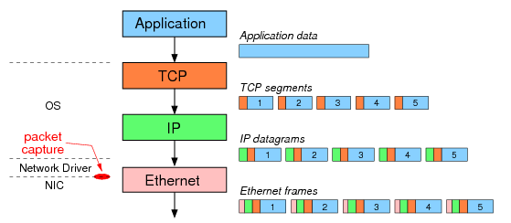
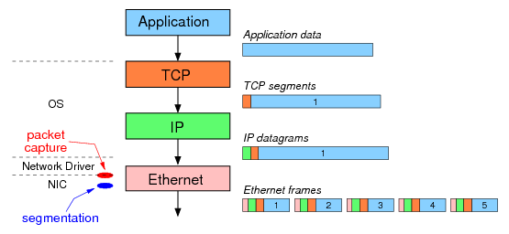
이런 경우도 있을 수 있음:
TCP Large Segment Offloading (TSO)
PC without TSO option
PC with TSO option
The result: although the same 5 Ethernet frames are sent over the network, Wireshark captures different data depending on the use of segmentation offloading.

